Slide 1
Main Street Advisors, LLC Investment Management Services Financial Planning
Summer 2024

Slide 2
Investment Management Services
History: | Founded in 1999
Ownership: | 100% owned by management
Assets Under Management: | ~$64,000,000
Clients: | Approximately 103 individuals and families
Investment Approach: | We seek to add value through strategic and tactical asset allocation and careful investment manager selection
Notes:
Depending on your firm’s assets under management, you may or may not want to include this information.

Slide 3
What Is Our Edge?
Objectivity We are fee-only and independent. Our only incentive is to generate good results.
All-Star Approach Exceptionally in-depth research, provided by a nationally recognized research team known for the depth and quality of their manager due diligence and asset class analysis.
Investment Experience Over thirty years navigating the financial and investment landscape.
Quality of Service We tailor an investment plan to your needs.
Notes:
We put a lot of emphasis on the importance of a disciplined and strongly research-oriented approach and also the service that we offer.
Objectivity is also important. The fact that this is a fee-based product is something that we believe the client may view as a plus.

Slide 4
Our Core Investment Beliefs
Global Perspective. We invest across a globally diverse set of asset classes in order to uncover the most attractive investment opportunities.
Long-Term Approach. A long-term approach allows us to take advantage of temporarily mispriced investments and helps ensure that fundamentals, rather than fear or greed, dictate investment decisions.
Forward-Looking Analysis. History provides a valuable frame of reference but does not always apply to the current environment. We seek to learn how the world is evolving and incorporate our opinions about these changes into our assessment of risk and investment allocations.
Discipline and Conviction. We set the bar high in assessing investment opportunities, and we have the discipline and conviction to act on an opportunity we find compelling. We believe that investors who lack the courage to act on their convictions are destined for mediocrity.
Innovative Thinking. Our willingness to think outside the box allows us to identify unusually compelling investment opportunities. This has been an important part of our competitive edge and our long-term success.
Broad Access to Talent: “Manager of the Managers.” Our reputation in the investment community provides us with unique access to investment talent from outside firms, via mutual funds and private investment vehicles, allowing us to incorporate a high level of expertise in a variety of asset classes that would otherwise not be available from a single firm. We are continuously evaluating the managers we’ve selected in order to ensure our clients are benefiting from the best talent available.

Slide 5
Client-Driven Portfolio Management
Investment Strategy Consistent with Client Risk Profile
Risk Assessment
Client-driven – Client information and discussion drive risk/return assessment
Threshold for Loss – Each portfolio has a one-year loss threshold.
Experience-Based – Professional investment advisors realize most clients overstate their tolerance for risk
No Guarantees – No guarantee that risk thresholds can be avoided.
Notes:
When we begin working with new clients we explain that our strategy is dependent on first understanding their risk tolerance. Then we seek to generate the best long-term return we can without violating the client’s shorter-term risk tolerance. We define risk tolerance as the loss threshold for one year.
If the client has an inconsistency between their return needs and risk tolerance then the advisor should discuss this with them and help them recognize that either risk needs to be increased or return objectives need to be lowered (or some combination of the two).
You can see our expected return ranges for each model by looking under the model portfolio tab and clicking on Expected Return Ranges on the left navigation bar, under Performance.

Slide 6
Our Investment Process
OUR PROVEN APPROACH TO INVESTING IS DECEPTIVELY SIMPLE
Establish a strategic asset allocation for each risk-based portfolio
Pursue highly compelling tactical opportunities
Select managers with an identifiable and sustainable competitive edge

Slide 7
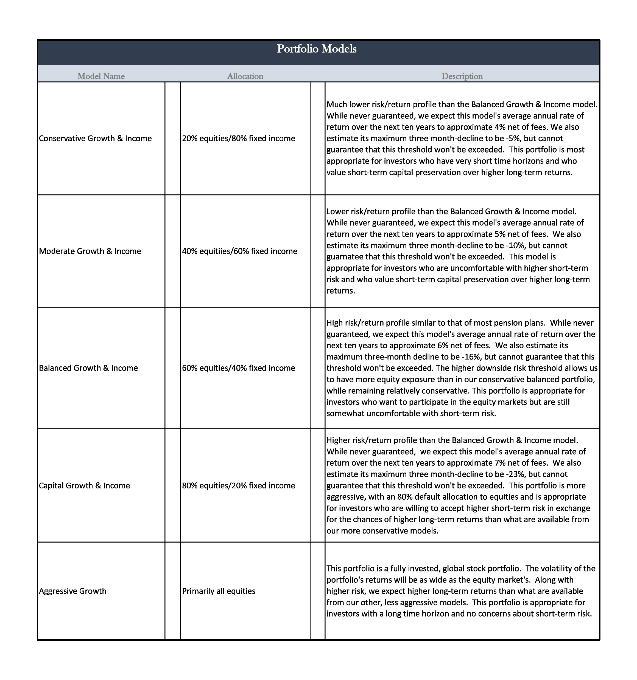
Five Risk-Defined Strategic Allocations
Five Risk-Defined Strategic Allocations
Though Main Street Advisors, LLC attempts not to exceed the loss threshold, losses sometimes exceed the threshold in a 12-month period. Though we don’t believe it is likely this maximum loss threshold would be breached in a typical market cycle, losses in excess of the threshold do occur, and significant breaches of this loss threshold can be expected during extreme bear markets. The above allocations represent our strategic portfolio weightings.

Slide 8
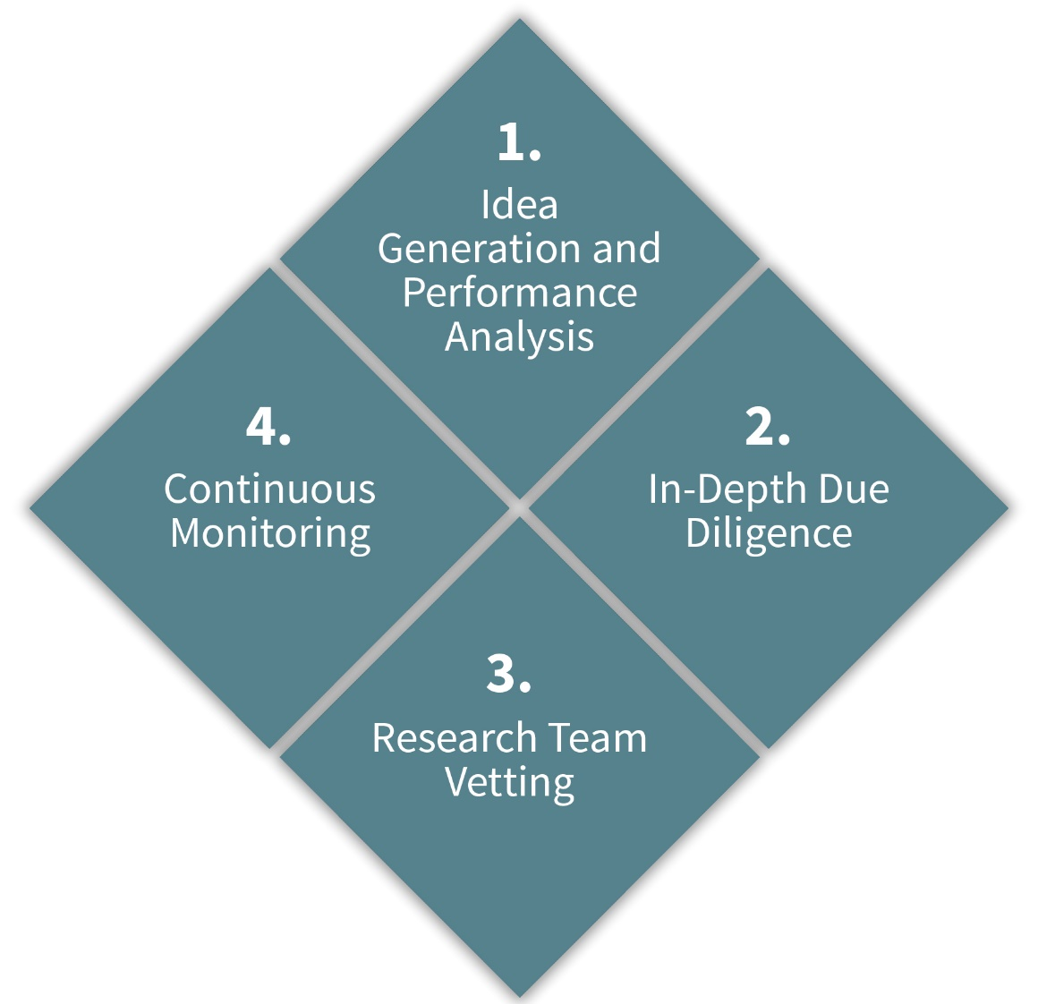
Best-of-Class Manager Selection
Best-of-Class Manager Selection
Manager
Due Diligence Process
QUANTITATIVE REVIEW FACTORS:
Performance consistency
Holdings analysis
Expenses
Risk-adjusted returns vs. peers
Volatility and downside risk
QUALITATIVE REVIEW FACTORS:
Integrity and discipline
A sustainable, repeatable edge
Stability and culture of the organization
Quality of the team
Shareholder orientation
“Intuition” is not part of the team’s process
8

Slide 9
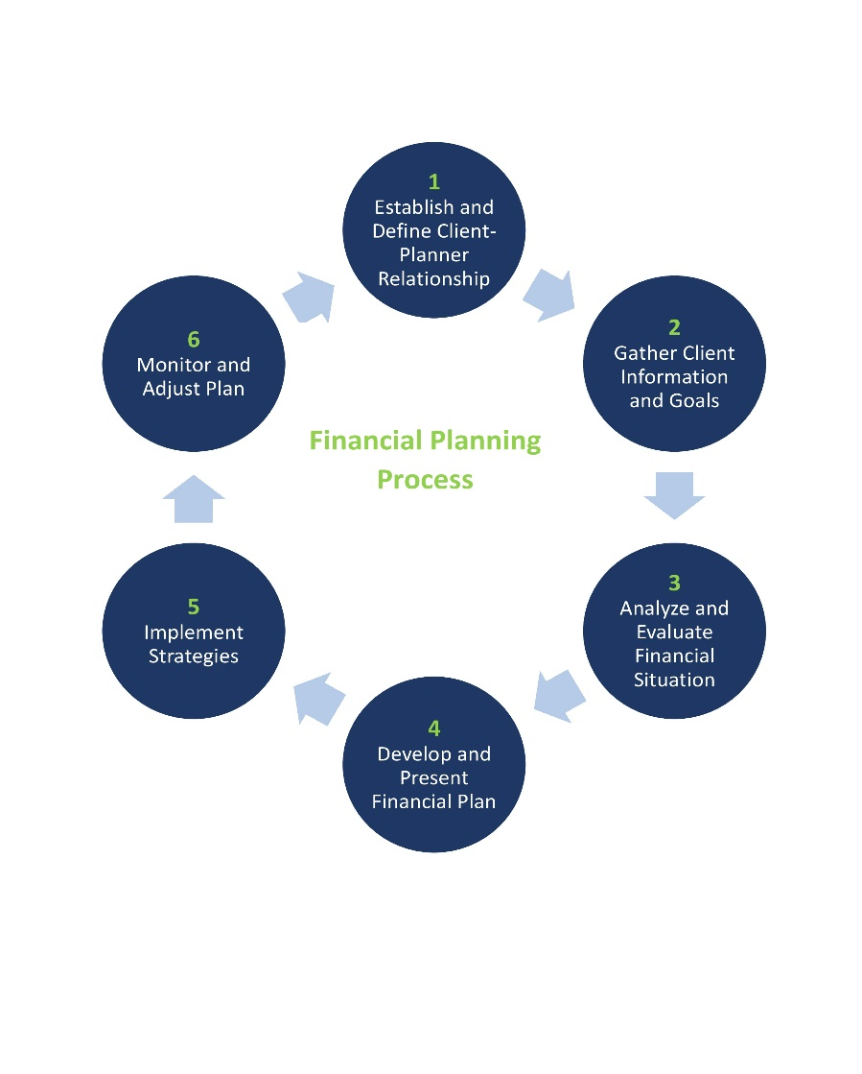
Financial Planning
Coming up with a solid financial plan means doing some homework – both on your part and the part of your CFP professional. From examining your current situation, to setting goals, to deciding how to measure your progress, a CFP professional is uniquely qualified to take you through the financial planning process.

Slide 10
MoneyGuide Pro
MoneyGuide Pro

Slide 11
MoneyGuide Pro
MoneyGuide Pro

Slide 12
Client Communication and Relationships
Strategies customized to meet each client’s goals and objectives (shy of an Investment Policy Statement)
Frequent communication
Monthly brokerage reports
Quarterly performance reports and portfolio appraisals
Quarterly client letter discussing outlook and strategy
Annual reviews (minimum)
Notes:
Your own service level will determine what is in this slide.

Slide 13
Investment Management Fee Schedule
Our only revenues are paid to us by our clients exclusively.
We are compensated based upon a percentage of assets under management. Our fee schedule is as follows:
1.50% up to $250,000
1.25% $250,000 - $500,000
1.0% $500,000 - $1,000,000
Less than 1.0% for assets in excess of $1,000,000
We do well when you do!

